Slide 1

Legal and Procedural Issues arising from GE2015
by Dr Jack Tsen-Ta Lee
School of Law, SMU
MARUAH Post-election Forum, 19 September 2015

Slide 2
Outline
Before the election:
  Position of the Elections Department.
  Redrawing of electoral boundaries.
During the campaign period:
  Election advertising on cooling-off day and polling day.
  Films.
After the election: NCMPs.

Slide 3
Before the Writ of Election

Slide 4
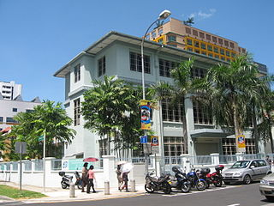
Elections Department’s Position
The Elections Department (ELD) is a department under the Prime Minister’s Office.
While there are few complaints about how the ELD conducts elections, to maintain impartiality should it be an independent commission?

Slide 5
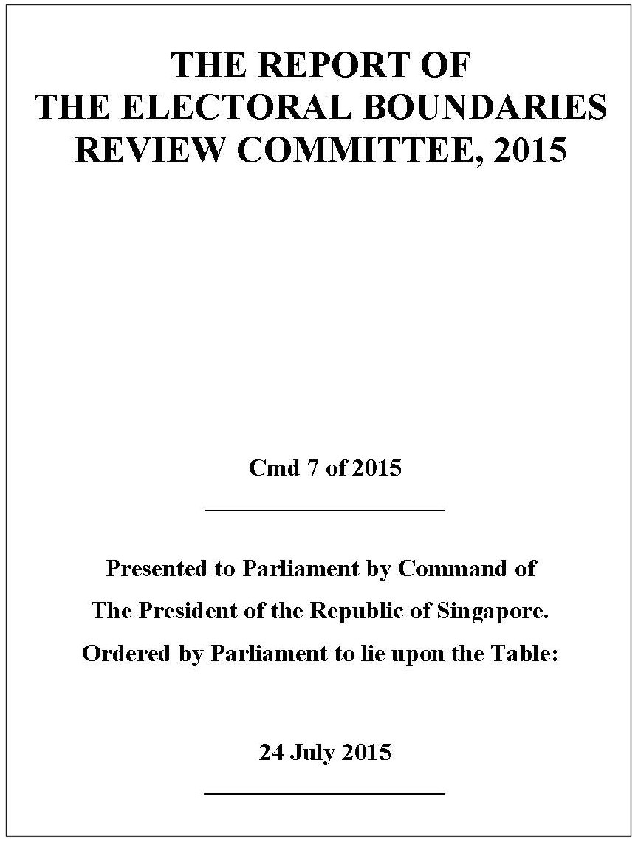
Electoral Boundaries
The Electoral Boundaries Review Committee’s recommendations on the adjustment of constituency boundaries always draws criticisms from voters and political parties.

Slide 6
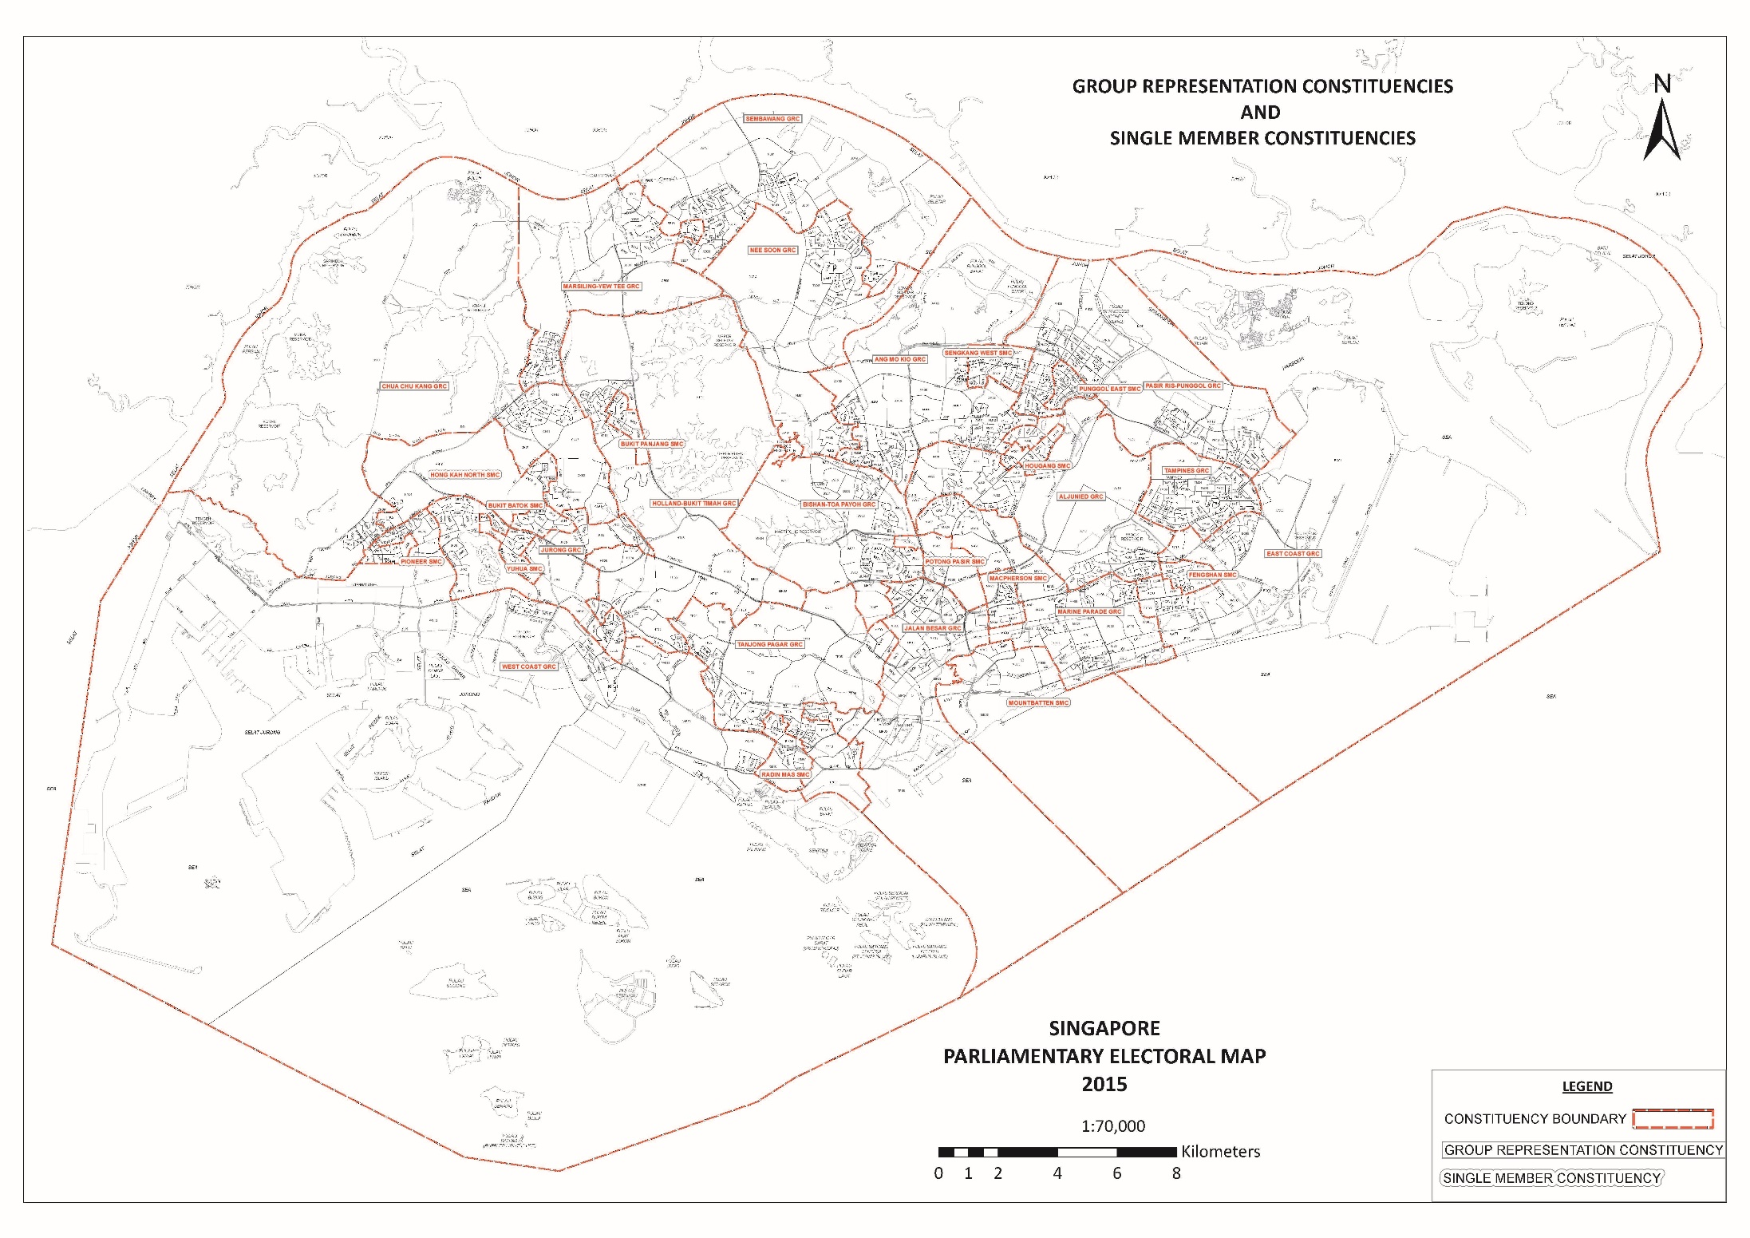
Electoral Boundaries

Slide 7
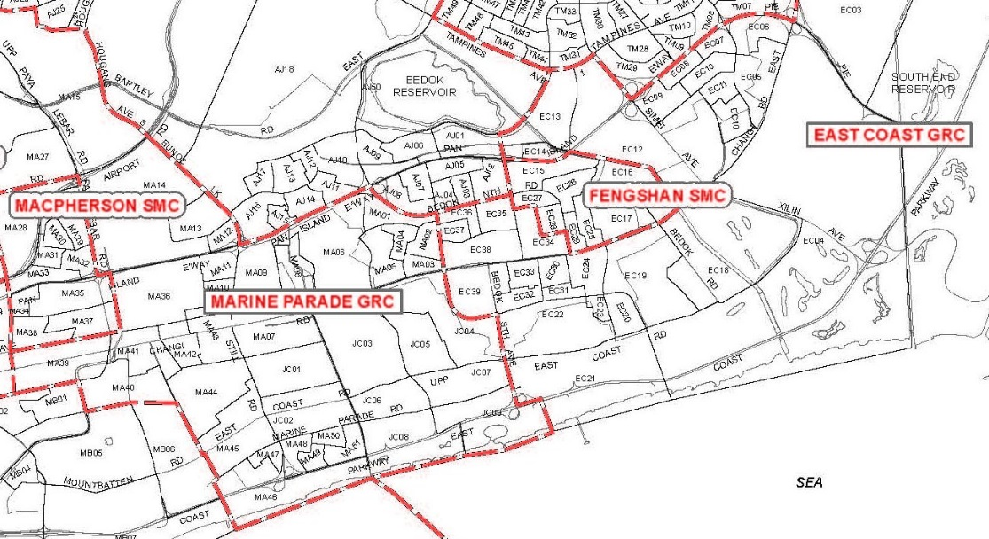
Electoral Boundaries
Not very convinced by the common argument that the constituency name seems far removed from the actual geographical location where a voter lives.
More relevant: have electoral boundaries have been redrawn unfairly to favour the incumbent party?
EBRC report gives no methodology details, apart from stating that there
should be 20,000 to
37,000 electors per
MP, with a ±30%
variation “as in past
practice”.

Slide 8
Electoral Boundaries
Should the EBRC issue a draft report and provide an opportunity for voters and political parties to submit representations on it, before the report is finalized?
Under the Malaysian Constitution:
  Proposed boundary changes must be published in the Government Gazette and in at least one newspaper in the affected constituency.
  People are given a month to make representations to the Electoral Commission, and if they are received an enquiry is held.
Should an independent Electoral Commission appoint and oversee the EBRC’s work?

Slide 9
During the Campaign Period

Slide 10
Online Engagement
The “campaign period” is from the close of nomination proceedings to the start of cooling-off day.
Political parties are required to notify the Returning Officer:
  Within 12 hours after the campaign period starts –the particulars of every Internet election advertising platform to be used.
  After that, before each form of Internet election advertising is published.
Is this too cumbersome?

Slide 11
Online Engagement
There is still confusion over what people can or cannot post on the Internet on cooling-off day and polling day.
Not helped by ELD’s advice: “The transmission of personal political views by individuals to other individuals, on a non-commercial basis, using the Internet, telephone or electronic means” is allowed.
But the law actually states that what is allowed is “the telephonic or electronic transmission by an individual to another individual of the first-mentioned individual’s own political views,
on a non-commercial basis”.

Slide 12
Online Engagement
The wording of the Parliamentary Elections Act, s 78B, suggests that one-to-many electronic transmissions, such as postings on social media, are actually not permitted by law.
Is this too rigid and impossible to enforce anyway?
Should the restriction be done away with (at least for voters who are not candidates or people working for them)?
But if the restriction is removed, does this defeat
the purpose of having a break from
campaigning on cooling-off day and polling
day?

Slide 13
Online Engagement
The Films Act prohibits the exhibition of “party political films”.
Essentially, a film will not be considered a party political film if it is purely factual and does not contain any dramatic elements.
Again, does this restrict creativity? Or is it better to keep the restrictions to prevent negative campaigning (such as the SDP’s Pappy Washing Powder YouTube video)?

Slide 14
After the Election

Slide 15
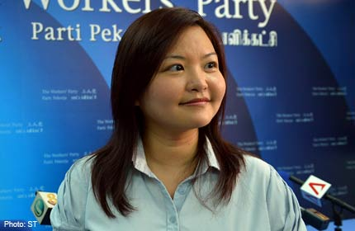
The NCMP Scheme
Under the Non-constituency Member of Parliament (NCMP) scheme, opposition candidates who are the ‘best losers’ in the general election will be declared elected as NCMPs.
The maximum number of NCMPs is nine less the number of opposition candidates elected.

Slide 16
The NCMP Scheme
Opposition candidates have priority to be declared elected according to their vote share, subject to the following rules:
  Each candidate must poll at least 15% of the votes in the constituency.
  No more than one candidate from each SMC, and no more than two candidates from each GRC, can be declared elected.
In GE2015, all the qualifying candidates are from the Workers’ Party.

Slide 17
The NCMP Scheme
As a result of Lee Li Lian, the best-performing unsuccessful opposition candidate, stating she will not take up an NCMP seat, there is some doubt about whether the WP can nominate someone to replace her.
PEA, s 53: if an NCMP fails to take MP’s Oath of Allegiance at the first or second sitting of Parliament after the general election, “Parliament may by resolution declare that his seat has become vacant and that it be filled by the next succeeding
candidate at the general election in the order
of priority…”

Slide 18
The NCMP Scheme
Jaclyn Neo pointed out in a Singapore Public Law blog post that this could mean if Parliament declares the seat vacant, it must go on to allow the seat to be filled.
But ELD says it was advised by the Attorney-General that Parliament can declare the seat vacant and not fill it.
Unlikely that the PAP-dominated Parliament will
declare the seat vacant and yet not allow it to be filled.

Slide 19
The NCMP Scheme
Will the WP apply to court if the PAP actually does that?
If Parliament does not declare the NCMP seat vacant, can Lee Li Lian opt to take up the seat in, say, after a year or two? Nothing in the law says she is barred from doing so.
These issues should probably be clarified.
Or should the NCMP scheme as a whole be scrapped, as the WP has called for? Despite limitations on
what NCMPs can vote on in Parliament, it
gives opposition politicians exposure.

Slide 20
Acknowledgements
Slide 4 (Elections Department): By Terence Ong [GFDL (http://www.gnu.org/copyleft/fdl.html), CC-BY-SA-3.0 (http://creativecommons.org/licenses/by-sa/3.0/) or CC BY 2.5 (http://creativecommons.org/licenses/by/2.5)], via Wikimedia Commons.
Slides 5–7 (Report of the Electoral Boundaries Review Committee, 2015): from the Elections Department website, © Government of Singapore.
Slide 15 (Lee Li Lian): from the AsiaOne website (http://news.asiaone.com/News/ Latest+News/Singapore/Story/A1Story20130428-418993.html), © 2013 Singapore Press Holdings.

Slide 21
Legal and Procedural Issues arising from GE2015
by Dr Jack Tsen-Ta Lee
School of Law, SMU
MARUAH Post-election Forum, 19 September 2015

