Slide 1
Maruah
Post-Elections Forum
19 Sep 2015
by
Dr Derek da Cunha

Slide 2
Singapore is a socially & politically conservative society
Massive logistical challenges
Mandatory voting
New media has zero impact in moving the vote against PAP
Ballot paper design and voter psychology

Slide 3
Low vote for SPP’s Jeannette
SDP’s Holland-Bukit Timah team failed to surmount 40%
Contest in Senglang West was not competitive
East Coast GRC was not competitive despite WP’s fine tactical battle

Slide 4
naturalised citizens claim
“brainwashing” claim
conspiracy theory

Slide 5
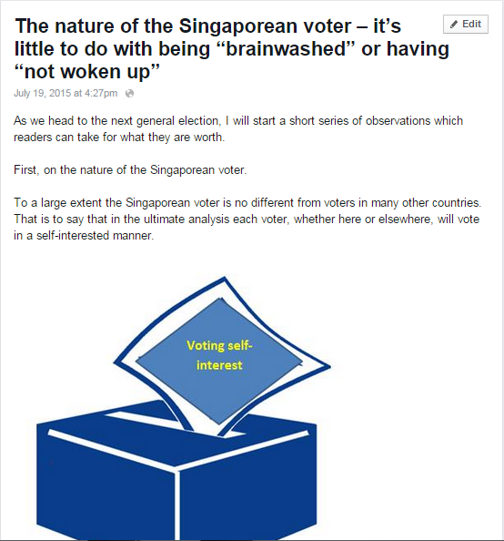

Slide 6
“… a majority of Singaporeans feel that they are beneficiaries of the current economic, social and political set-up.”
-- FB Note July 19, 2015

Slide 7
naturalised citizens claim
“brainwashing” claim
conspiracy theory

Slide 8
All GRCs should be 4 member
EBRC should publish its report no less than 4 mths before Polling Day
No piecemeal changes to the elections process

Slide 9
The END
http://www.facebook.com/DerekdaCunha

