Slide 1


Slide 2


Slide 3
I’ve been asked to touch on:
Campaign
Results
What now/next?

Slide 4
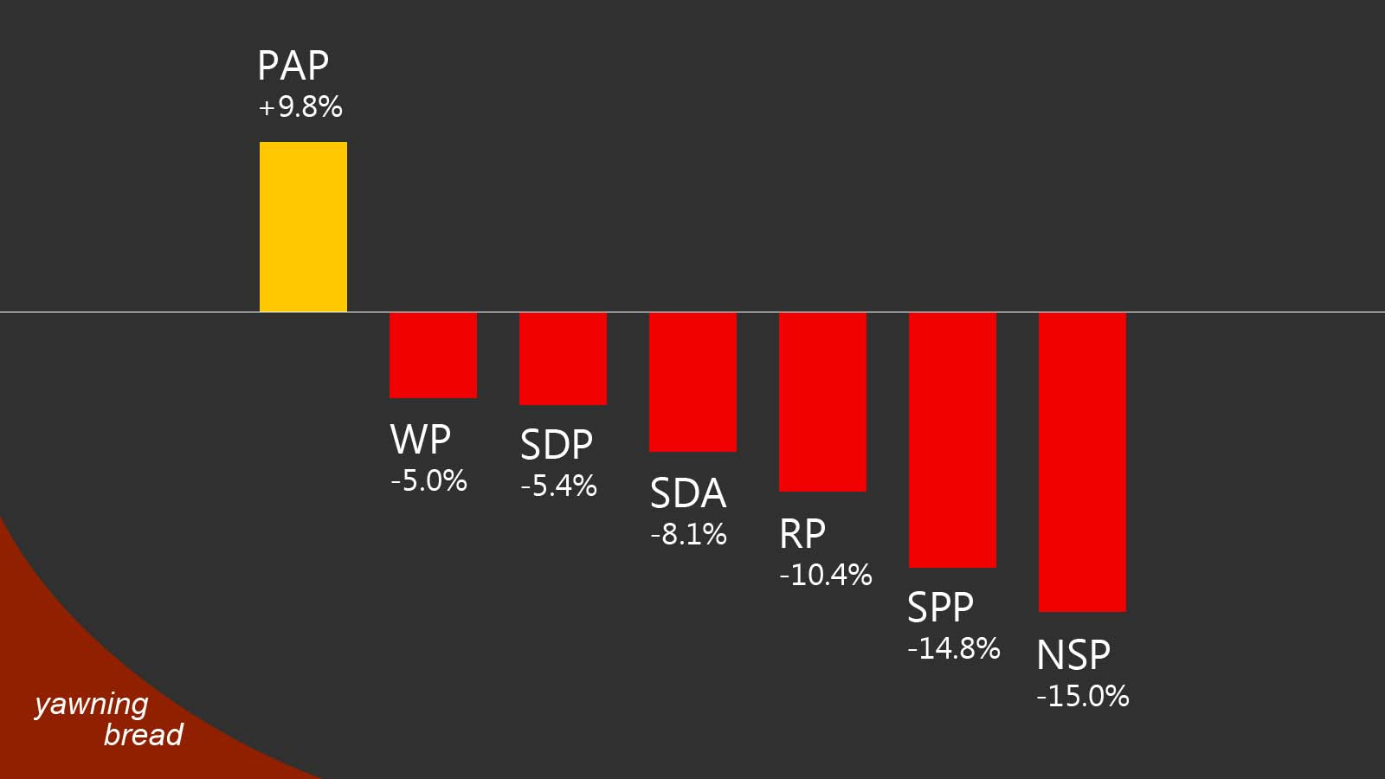
% vote-share change*
*In the case of opposition parties, comparison restricted to same (or nearly same) constituencies contested in 2011 and 2015.

Slide 5
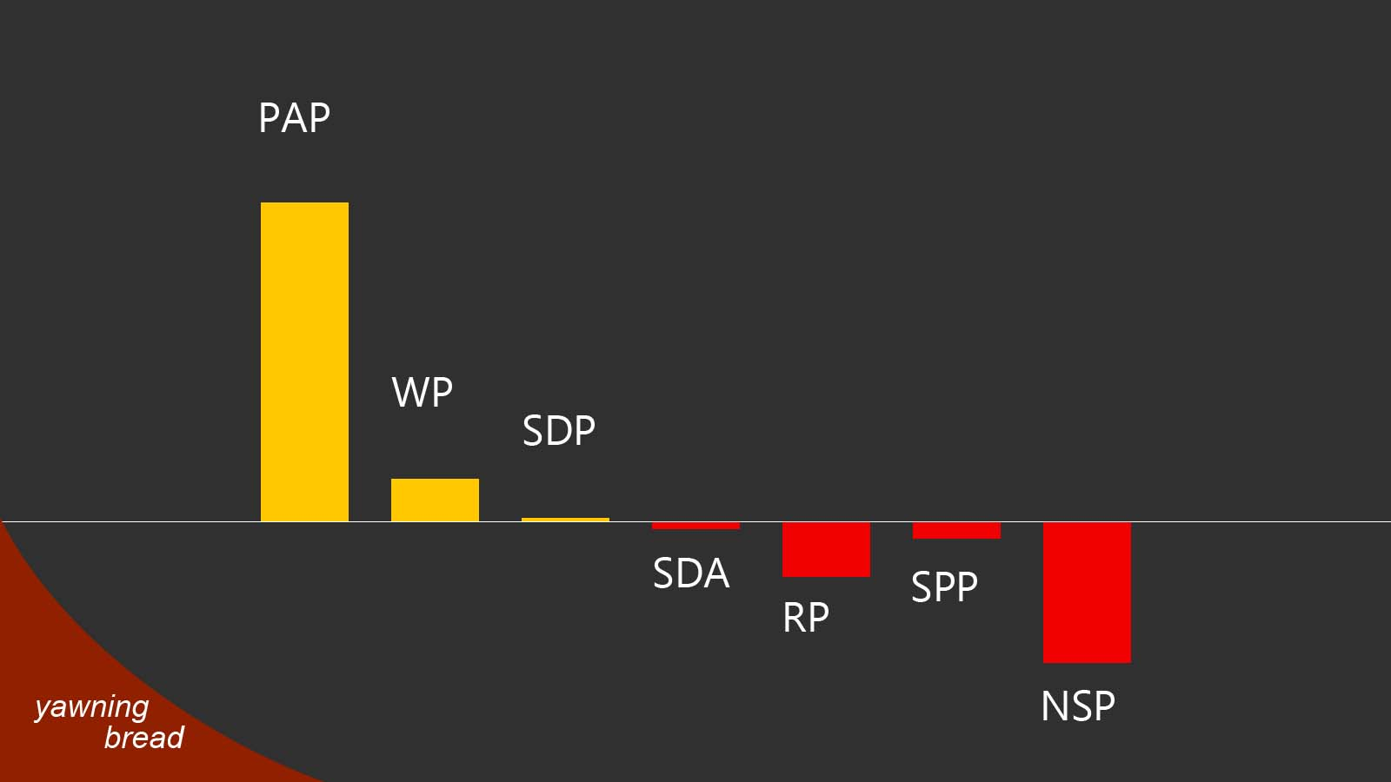

Slide 6
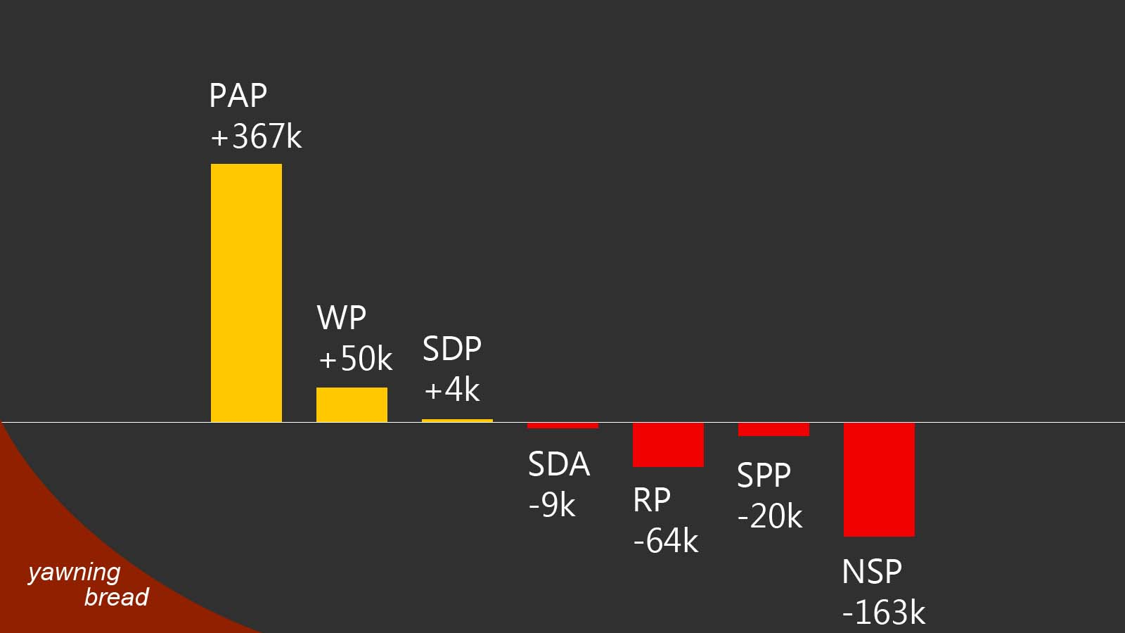
Change in absolute number of votes

Slide 7
3-WAY CONTESTS
Disaster for the weaker opposition party;
Similarly seen in 2011 and 2013 Punggol East elections.

Slide 8
PARTY BRAND: A BIG ASSET
Need to create distinct and substantive values for the brand;
Don’t be afraid to criticise other opposition parties;
No horse-trading, no coalition.

Slide 9
Why not coalition when Pakatan Rakyat successful in Malaysia?
Enough Malaysians want an alternative govt – coalition helps satisfy that desire;
Majority Singaporeans afraid of losing PAP govt – coalition increases that fear.

Slide 10
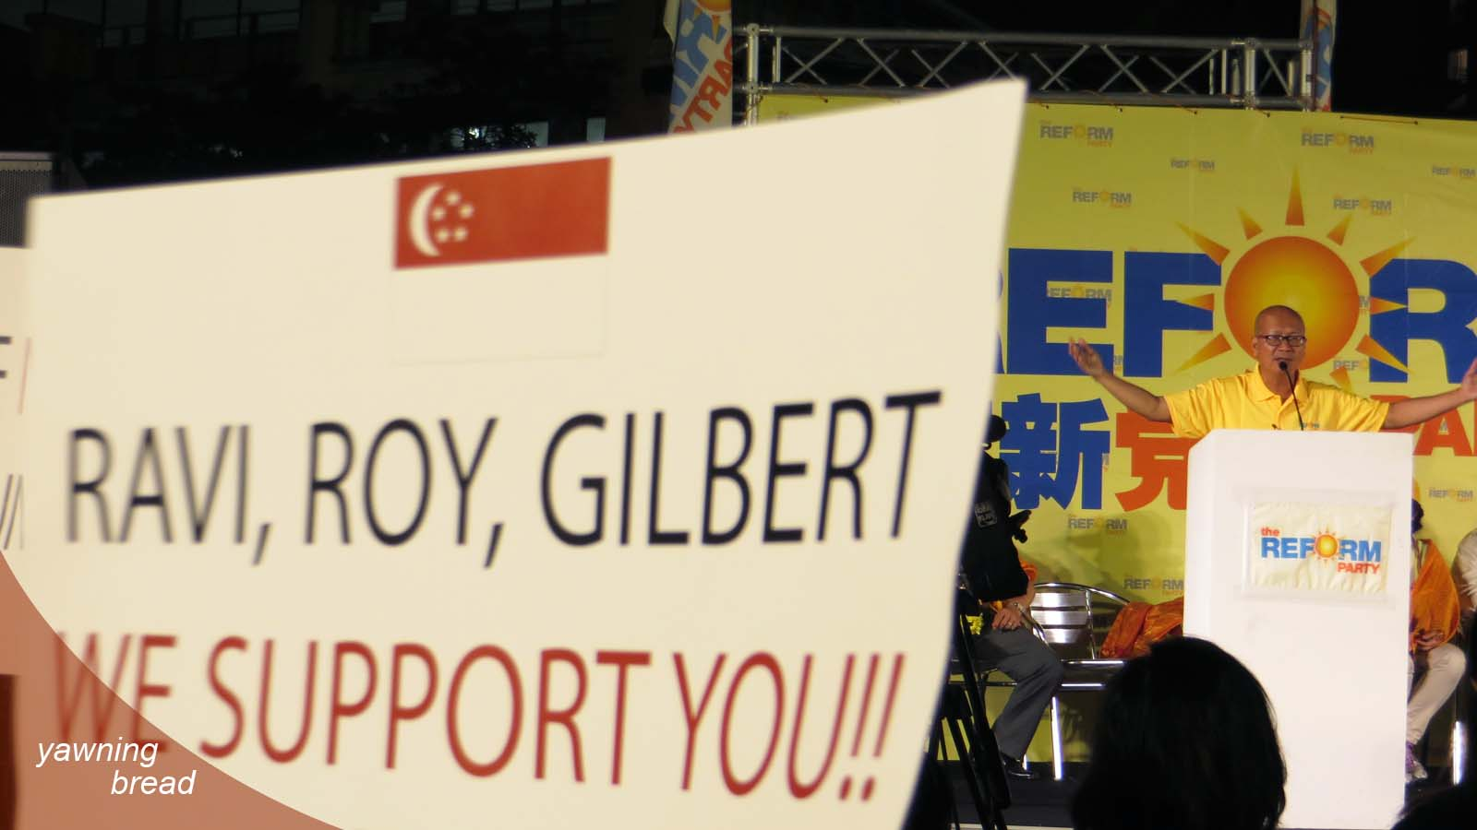

Slide 11
ANTI-IMMIGRATION CRIES
Immigration has winners and losers;
Anti-immigration easily segues into anti-foreigner;
Voting result? A big turn-off.

Slide 12
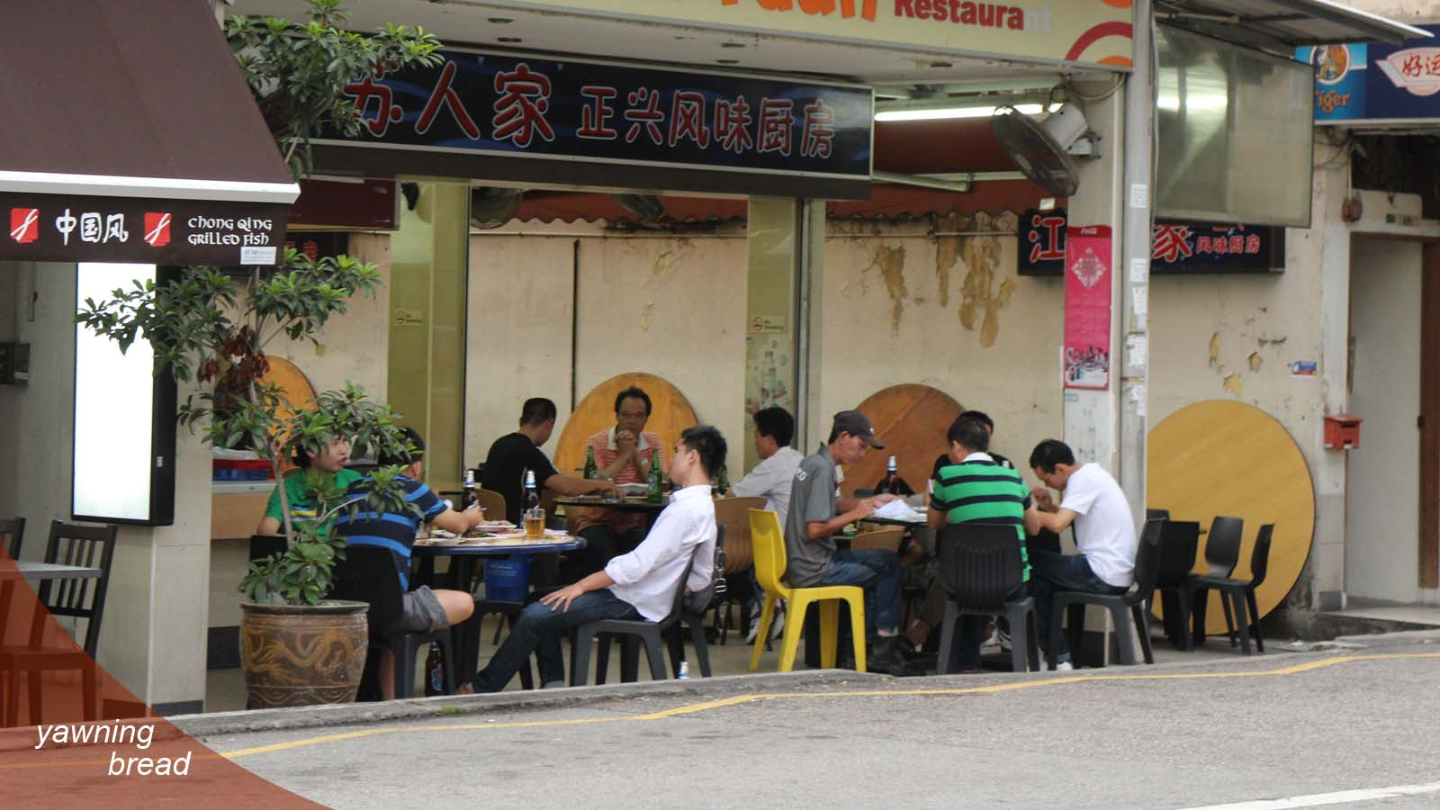

Slide 13
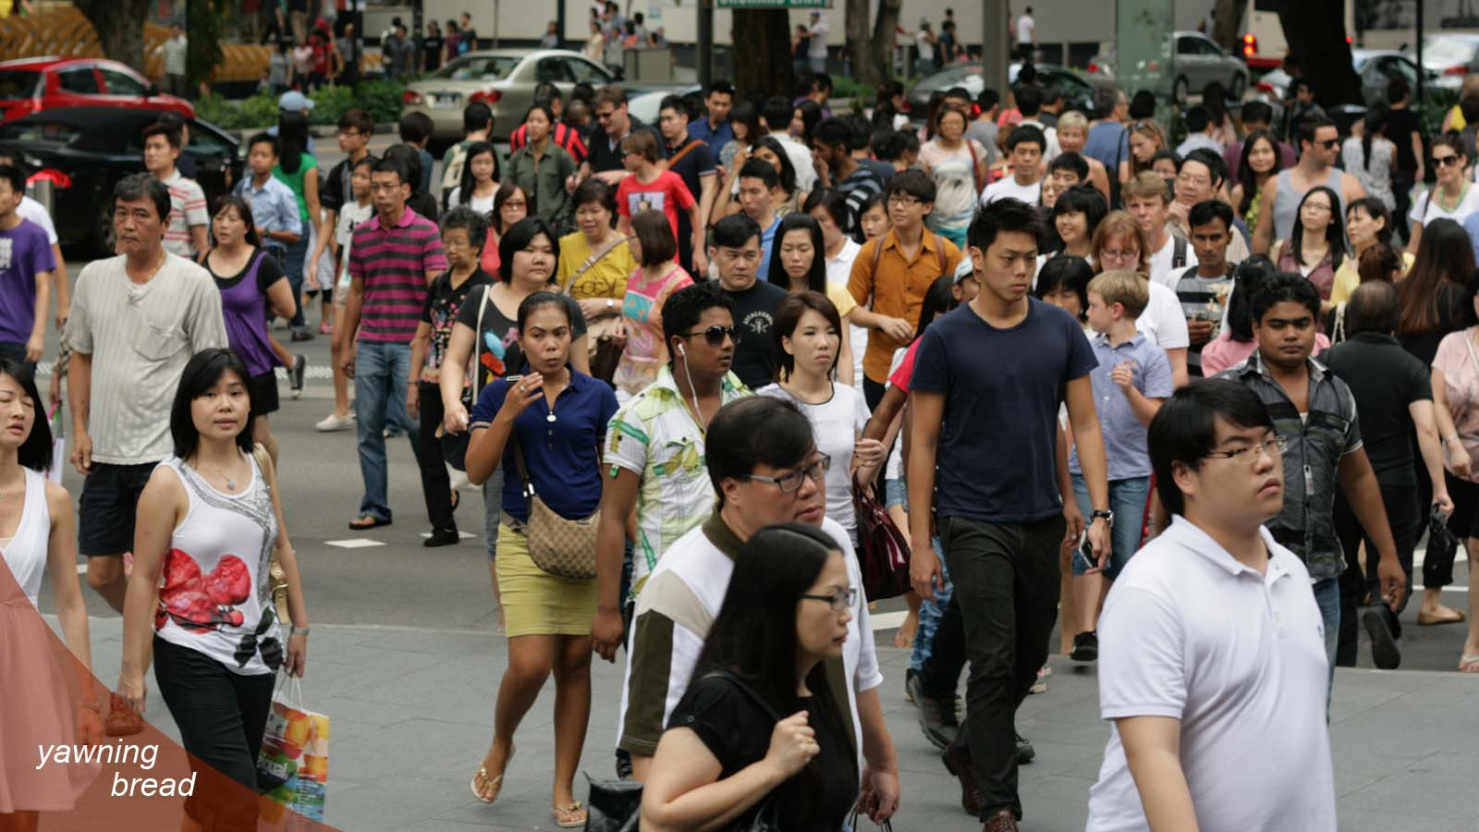

Slide 14
AS MORE NEW CITIZENS COME IN…
Opposition parties should consider speaking up for them;
Find candidates from among them.

Slide 15
CHECK AND BALANCE
Should still be an appealing message;
Must be supported by party brand values;
Cannot be devoid of ideology.

Slide 16
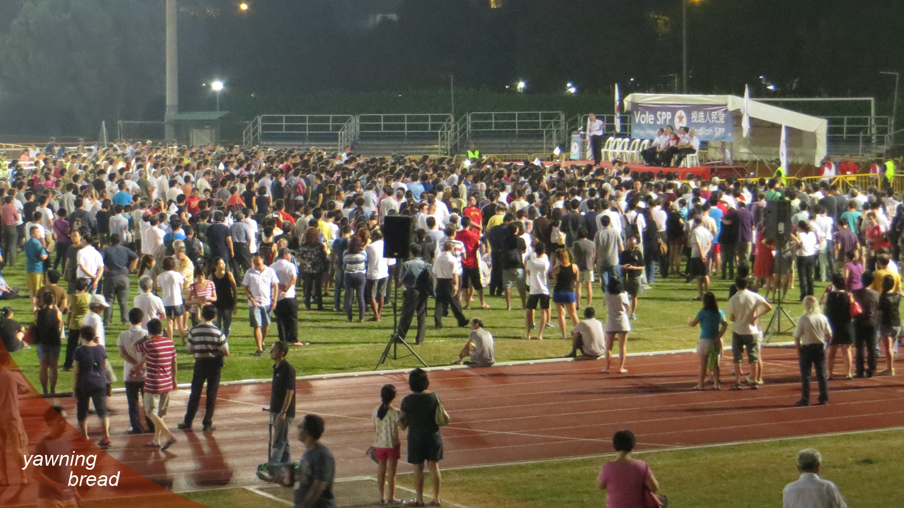

Slide 17
CHECK AND BALANCE
What questions are you going to ask?
How will such questions lead to better governance?

Slide 18
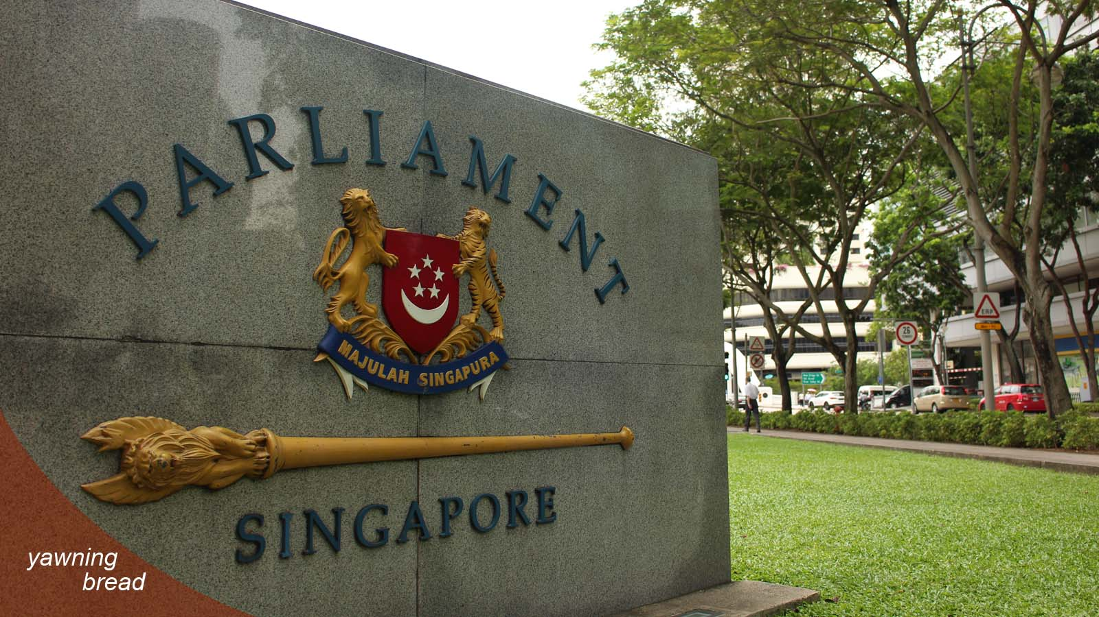

Slide 19
CHECK AND BALANCE: WP’s TRACK RECORD
Could have asked more questions;
Could have pressed the issues harder;
Were too low-key in publicising their efforts at parliamentary questions.

Slide 20
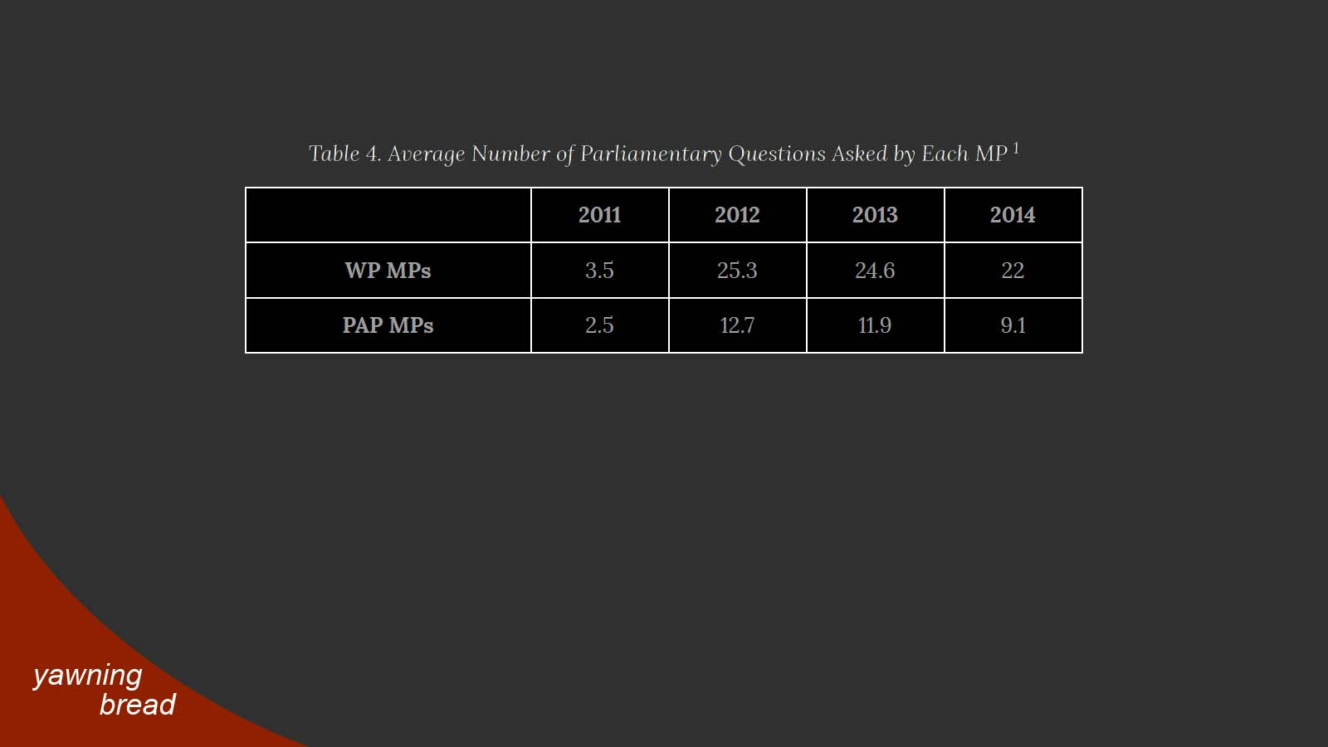

Slide 21
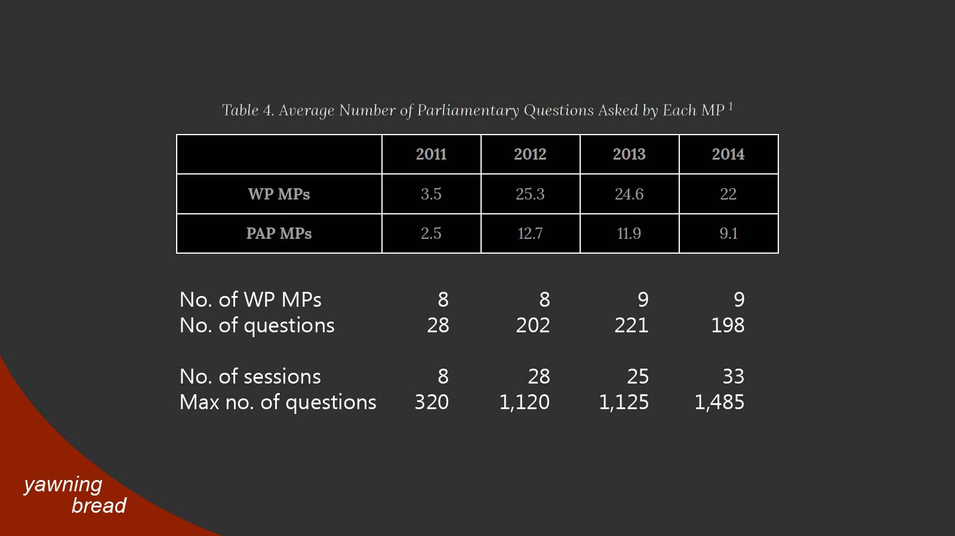

Slide 22
WHERE TO GET QUESTIONS?
Ask Singaporeans at large;
Ask civil society groups;
Go back to same parties for suggestions for follow-up questions;
Widen the spread of stake-holders.

Slide 23
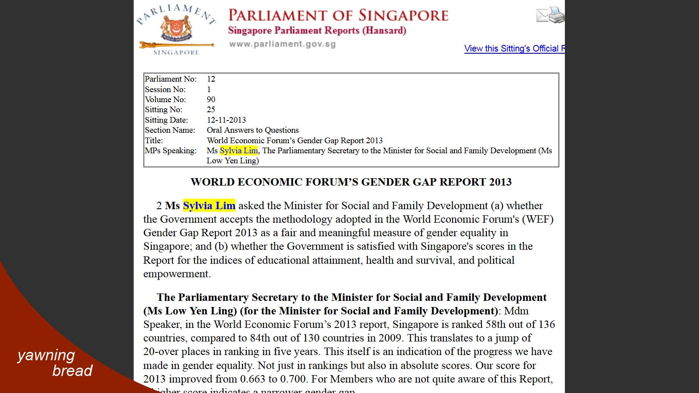

Slide 24
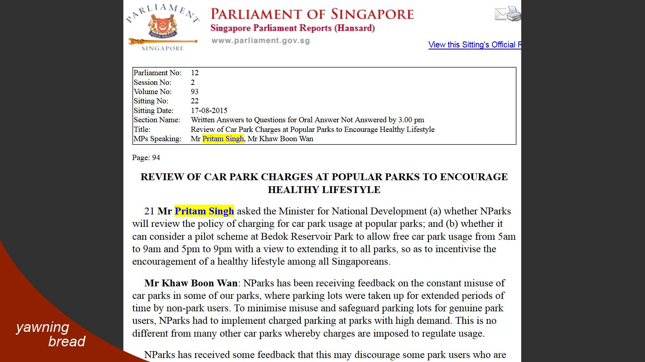

Slide 25
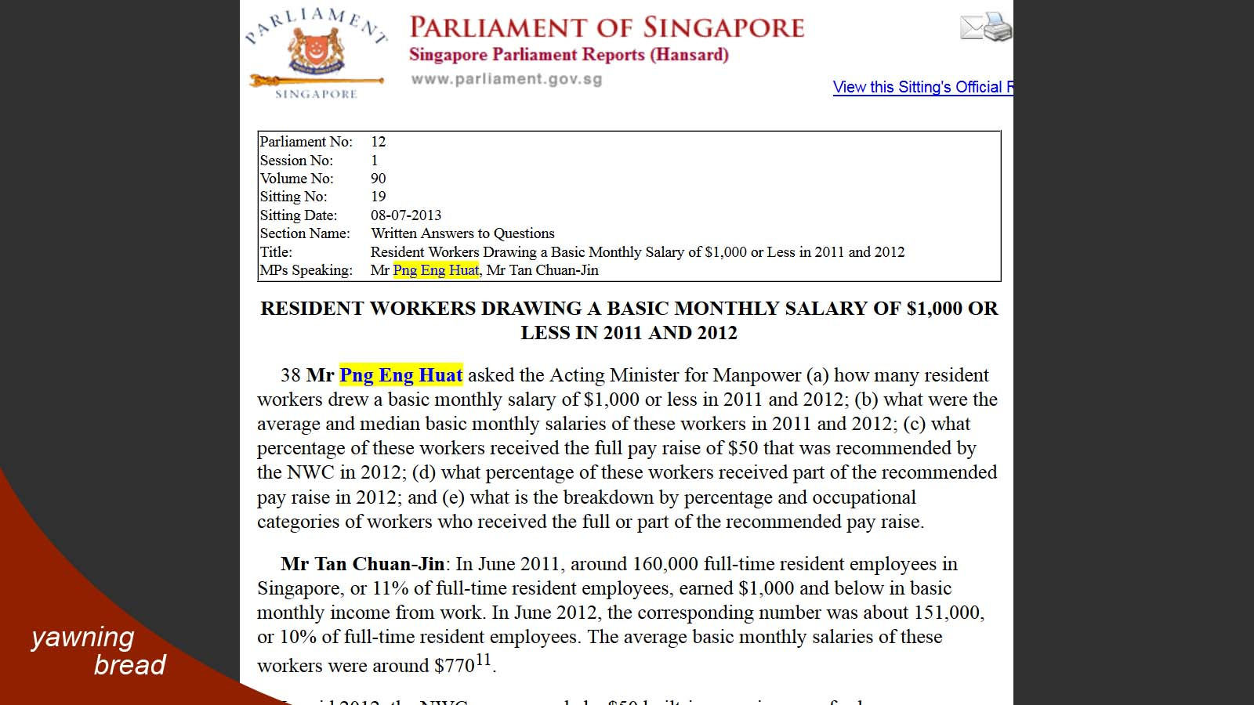

Slide 26
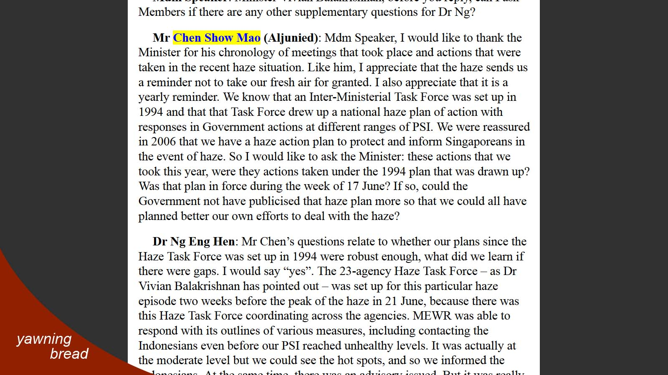

Slide 27
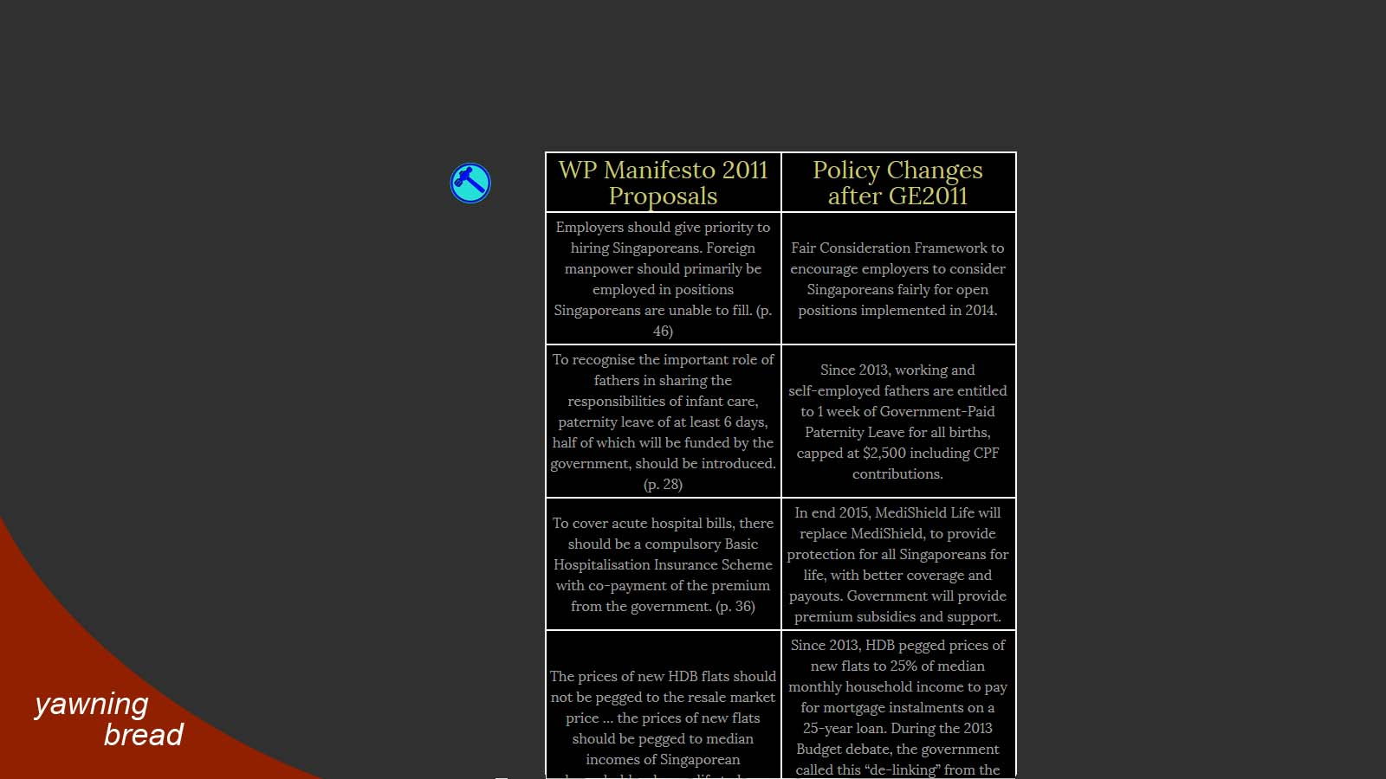

Slide 28
CHECK AND BALANCE: WP’s TRACK RECORD
Could have asked more questions;
Could have pressed the issues harder;
Too low-key in publicising their efforts at parliamentary questions, and nudging policy.

Slide 29
STRUCTURAL IMPEDIMENTS TO TRUE DEMOCRACY
Restrictions on civil liberties, free media;
To avoid addressing them is self-defeating;

Slide 30
STRUCTURAL IMPEDIMENTS TO TRUE DEMOCRACY
Restrictions on civil liberties, free media;
To avoid addressing them is self-defeating;
Then educate them.
But Singaporeans aren’t concerned about such things!

Slide 31
